Slide 1
CPR E 281: Digital Logic
Md Maruf Ahamed
Office: 307 Durham Center
Phone: (515) 294-6323
Email: maruf@iastate.edu

Slide 2
Administrative Stuff
  Homework: HW#9 due on Sunday @ 11:59 PM
  Quiz: Quiz #11 due on Friday @ 4:25 PM
  Recitation: Recitation 10 this week
  Lab: Lab 10 this week
  Lecture-32 Readings: 6.7

Slide 3
31-State Minimization
  Synchronous Sequential Circuits
    Moore Machine
    Mealy Machine
  Designing an Arbiter Circuit
  State Minimization

Slide 4
Serial Adder & Arbiter Circuit
Readings 6.5, 6.8

Slide 5
Arbiter Circuit

Slide 6
Conceptual Diagram
Request1
Grant1
Device 1
Request2
Arbiter
Shared
Grant2
Device 2
resource
Request3
Grant3
Device 3

Slide 7
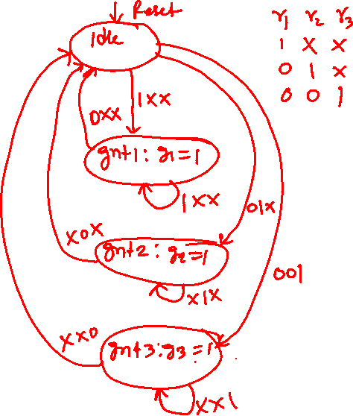
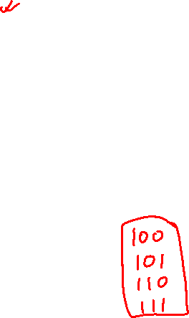
State diagram for the arbiter
[ Figure 6.72 from the textbook ]

Slide 8
State diagram for the arbiter
Reset
000
Idle
Highest Priority Device
0xx
1xx
gnt1
⁄
g
=
1
1
x0x
1xx
01x
gnt2
⁄
g
=
1
2
Lowest Priority Device
xx0
x1x
001
gnt3
⁄
g
=
1
3
xx1

Slide 9
State diagram for the arbiter
000
The three request bits
Reset
r₁ r₂ r₃
Idle
0xx
1xx
gnt1
⁄
g
=
1
1
x0x
1xx
01x
gnt2
⁄
g
=
1
2
xx0
x1x
001
gnt3
⁄
g
=
1
3
xx1

Slide 10
State diagram for the arbiter
Each device must
release the resource
after it is done using it
Reset
000
Idle
0xx
1xx
gnt1
⁄
g
=
1
1
x0x
1xx
01x
gnt2
⁄
g
=
1
2
xx0
x1x
001
gnt3
⁄
g
=
1
3
xx1

Slide 11
Alternative style of state diagram for the arbiter
r
r
r
Reset
1
2
3
Idle
r
r
1
1
gnt1
⁄
g
=
1
1
r
r
r
r
2
1
1
2
gnt2
⁄
g
=
1
2
r
r
r
r
r
3
2
1
2
3
gnt3
⁄
g
=
1
3
r
3
[ Figure 6.73 from the textbook ]

Slide 12
This design has one flaw:
If device1 and device2 raise requests all the time, then device3 will never get serviced.

Slide 13

This state diagram solves this problem
Reset
000
Idle
0xx
1xx
gnt1
⁄
g
=
1
1
x0x
1xx
01x
gnt2
⁄
g
=
1
2
xx0
x1x
001
gnt3
⁄
g
=
1
3
xx1

Slide 14
Let's look at a simpler example with only two devices that need to use the shared resource

Slide 15

State diagram for the simpler arbiter
Reset
00
Idle
0x
1x
gnt1
⁄
g
=
1
1
x0
1x
01
gnt2
⁄
g
=
1
2
x1

Slide 16
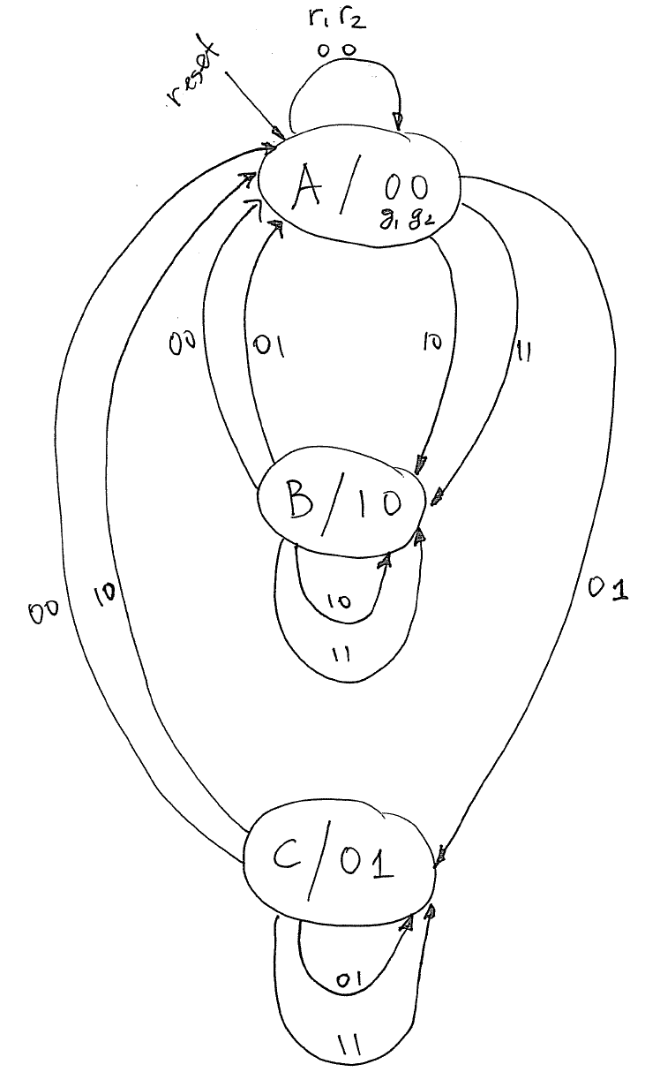
State diagram for the arbiter circuit
Reset
00
Idle
0x
1x
gnt1
⁄
g
=
1
1
x0
1x
01
gnt2
⁄
g
=
1
2
x1

Slide 17
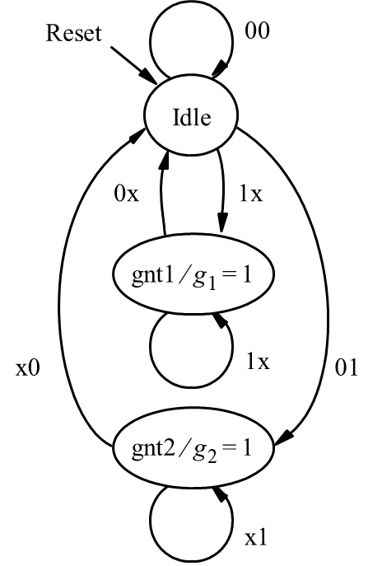
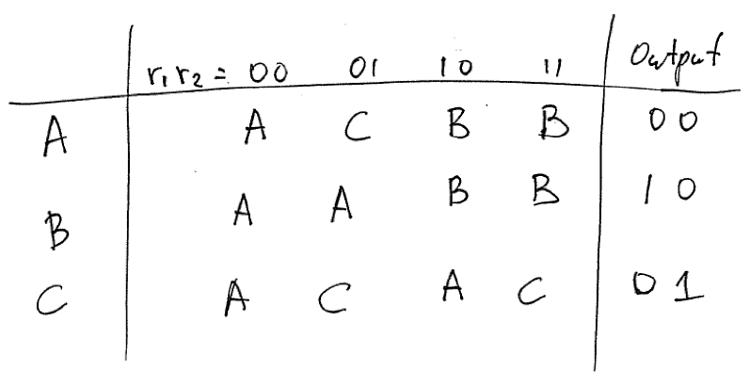
State Table

Slide 18


State-Assigned Table
Next state
Present
state
r₁r₂
=00
01
10
11
Output
y
y
g₁g₂
2
1
Y
2
Y
1
A
B
C
0 0
0
0
1 0
0
1
0 1
0 0
0 1
0
0
0 0
0
1
0 1
1 0
1 0
0
0
1 0
0
0
1 0
0 1
1 1
d
d
d d
d
d
d d
d d

Slide 19
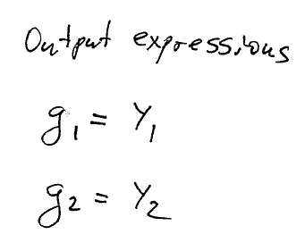

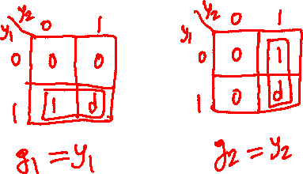
State-Assigned Table
Next state
Present
state
r₁r₂
=00
01
10
11
Output
y
y
g₁g₂
2
1
Y
2
Y
1
A
B
C
0 0
0
0
1 0
0
1
0 1
0 0
0 1
0
0
0 0
0
1
0 1
1 0
1 0
0
0
1 0
0
0
1 0
0 1
1 1
d
d
d d
d
d
d d
d d

Slide 20
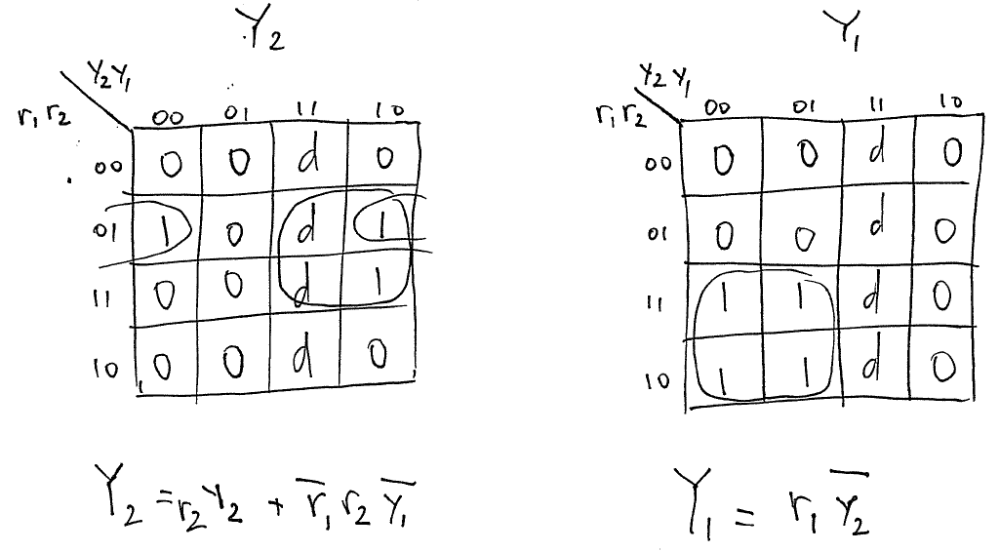
Next State Expressions

Slide 21
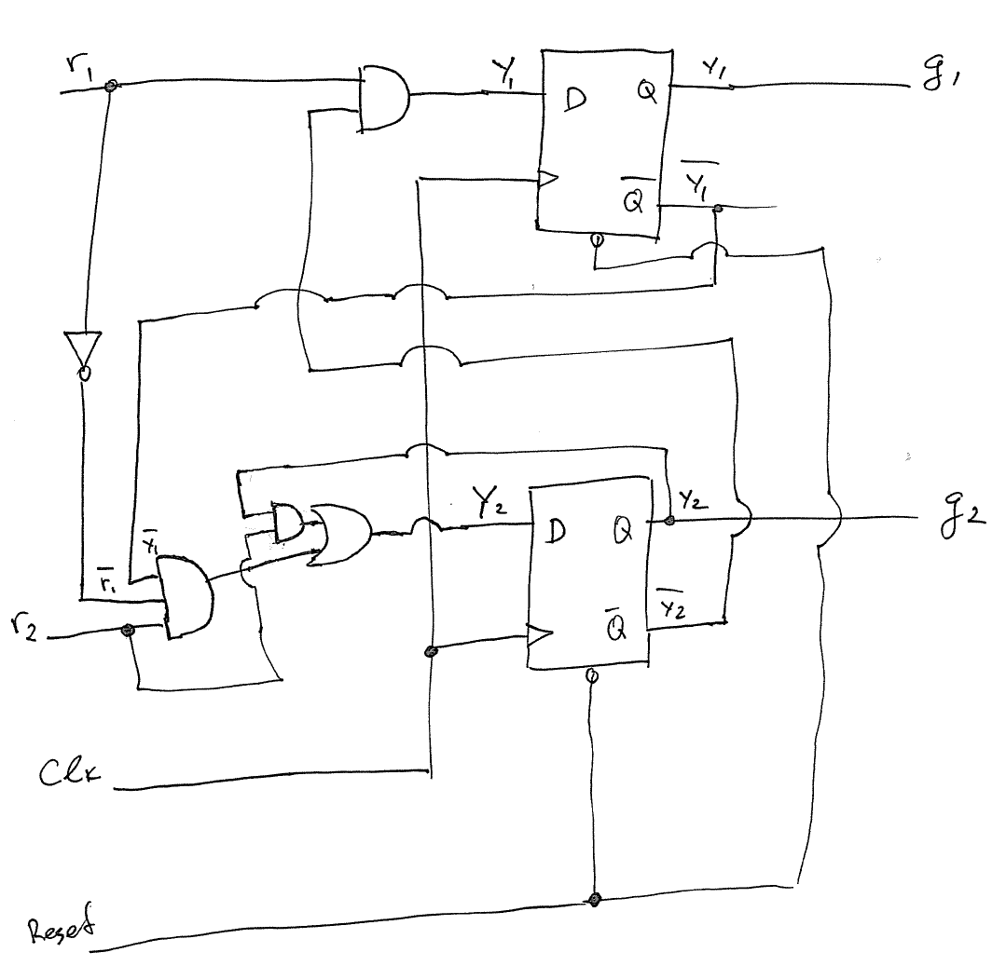
Circuit Diagram

Slide 22
State Minimization
Readings 6.6

Slide 23
State Minimization : Motivation
When a designer has to design a more complex FSM, it is likely that the initial attempt will result in a machine that has more states than is actually required.
Minimizing the number of states is of interest because fewer flips-flops may be needed to represent the states and the complexity of the combinational circuit needed in the FSM may be reduced
It is possible to define a minimization procedure that searches for any states that are equivalent. Such a procedure is very tedious to perform manually, but it can be automated for use in CAD tools.

Slide 24
Equivalence of states
If the number of states in an FSM can be reduced, then some states in the original design must be equivalent to other states in their contribution to the overall behavior of the FSM. We can express this more formally in the following definition.
“Two states S_{i} and S_{j} are said to be equivalent if and only if for every possible input sequence, the same output sequence will be produced regardless of whether S_{i} or S_{j} is the initial state.”
[ Page 374 in the textbook ]

Slide 25
Partition Minimization Procedure

Slide 26
Equivalence of states
“If states S_{i} and S_{j} are equivalent, then their corresponding k-successors (for all k) are also equivalent.”
[ Page 374 in the textbook ]

Slide 27
0-successor
Assuming that we have only one input signal w
S₁
w = 0
S₂
S₂ is a 0-successor of S₁

Slide 28
0-successor
Assuming that we have only one input signal w
S₁
w = 0
S₂
S₂ is a 0-successor of S₁
S₂ is a 0-successor of S₅
w = 0
S₅

Slide 29
1-successor
Assuming that we have only one input signal w
S₃
w = 1
S₄
S₄ is a 1-successor of S₃

Slide 30
1-successor
Assuming that we have only one input signal w
S₃
w = 1
S₄
S₄ is a 1-successor of S₃
S₄ is a 1-successor of S₆
w = 1
S₆

Slide 31
1-successor
Assuming that we have only one input signal w
S₃
w = 1
S₄
S₄ is a 1-successor of S₃
S₄ is a 1-successor of S₆
w = 1
w = 1
S₆
S₇
S₇ is a 1-successor of S₄

Slide 32
k-successors of a State
Assuming that we have only one input signal w,
then k can only be equal to 0 or 1.

Slide 33
k-successors of a State
Assuming that we have only one input signal w,
then k can only be equal to 0 or 1.
In other words, this is the familiar 0-successor
or 1-successor case.
S₁
w = 0
S₂
S₂ is a 0-successor of S₁
w = 1
S₃
S₃ is a 1-successor of S₁

Slide 34
k-successors of a State
If we have two input signals, e.g., w₀ and w₁,
then k can only be equal to 0,1, 2, or 3.

Slide 35
k-successors of a State
If we have two input signals, e.g., w₀ and w₁,
then k can only be equal to 0,1, 2, or 3.
S₂
w₀=1, w₁ = 1
S₁
S₁ is a 3-successor of S₂
S₄
w₀=1, w₁ = 1
S₄ is a 3-successor of S₂

Slide 36
Equivalence of states
“If states S_{i} and S_{j} are equivalent, then their corresponding k-successors (for all k) are also equivalent.”
[ Page 374 in the textbook ]

Slide 37
Partition
“A partition consists of one or more blocks, where each block comprises a subset of states that may be equivalent, but the states in a given block are definitely not equivalent to the states in other blocks.”
[ Page 374 in the textbook ]

Slide 38
State Table for This Example
Present
Next state
Output
state
w
=
0
w
=
1
z
A
B
C
1
B
D
F
1
C
F
E
0
D
B
G
1
E
F
C
0
F
E
D
0
G
F
G
0
[ Figure 6.51 from the textbook ]

Slide 39
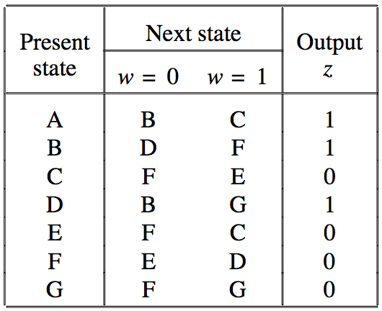
State Diagram
(just the states)
B
C
E
A
G
D
F

Slide 40
State Diagram
(transitions when w=0)
B
C
E
A
G
D
F

Slide 41
State Diagram
(transitions when w=1)
B
C
E
A
G
D
F

Slide 42
Outputs
B
C
z=1
z=0
E
z=0
A
z=1
G
D
z=0
z=1
F
z=0

Slide 43
Partition
Let us assume initially that all states are equivalent; this forms the initial partition, P1, in which all states are in the same block.
As the next step, we will form the partition P2 in which the set of states is partitioned into blocks such that the states in each block generate the same output values. Obviously, the states that generate different outputs cannot possibly be equivalent.
Then we will continue to form new partitions by testing whether the k-successors of the states in each block are contained in one block. Those states whose k-successors are in different blocks cannot be in one block. Thus, new blocks are formed in each new partition.
The process ends when a new partition is the same as the previous partition. Then all states in any one block are equivalent.

Slide 44
Partition #1
(All states in the same partition)
B
C
z=1
z=0
E
z=0
A
z=1
G
D
z=0
z=1
F
z=0

Slide 45
Partition #1
(ABCDEFG)
B
C
z=1
z=0
E
z=0
A
z=1
G
D
z=0
z=1
F
z=0

Slide 46
Partition #2
(based on outputs)
B
C
z=1
z=0
E
z=0
A
z=1
G
D
z=0
z=1
F
z=1
z=0
z=0

Slide 47
Partition #2
(ABD)(CEFG)
B
C
z=1
z=0
E
z=0
A
z=1
G
D
z=0
z=1
F
z=1
z=0
z=0

Slide 48
Partition #3.1
(Examine the 0-successors of ABD)
B
C
z=1
z=0
E
z=0
A
z=1
G
D
z=0
z=1
F
z=0

Slide 49
Partition #3.1
(Examine the 1-successors of ABD)
B
C
z=1
z=0
E
z=0
A
z=1
G
D
z=0
z=1
F
z=0

Slide 50
Partition #3.2
(Examine the 0-successors of CEFG)
B
C
z=1
z=0
E
z=0
A
z=1
G
D
z=0
z=1
F
z=0

Slide 51
Partition #3.2
(Examine the 1-successors of CEFG)
B
C
z=1
z=0
E
z=0
A
z=1
G
D
z=0
z=1
F
z=0

Slide 52
Partition #3.2
(Examine the 1-successors of CEFG)
B
C
z=1
z=0
E
z=0
A
z=1
G
D
This needs to be
in a new block
z=0
z=1
F
z=0

Slide 53
Partition #3
(ABD)(CEG)(F)
B
C
z=1
z=0
E
z=0
A
z=1
G
D
z=0
z=1
F
z=0

Slide 54
Partition #3
(ABD)(CEG)(F)
B
C
z=1
z=0
E
z=0
A
z=1
G
D
z=0
z=1
F
z=0

Slide 55
Partition #4.1
(Examine the 0-successors of ABD)
B
C
z=1
z=0
E
z=0
A
z=1
G
D
z=0
z=1
F
z=0

Slide 56
Partition #4.1
(Examine the 1-successors of ABD)
B
C
z=1
z=0
E
z=0
A
z=1
G
D
z=0
z=1
F
z=0

Slide 57
Partition #4.1
(Examine the 1-successors of ABD)
This needs to be
in a new block
B
C
z=1
z=0
E
z=0
A
z=1
G
D
z=0
z=1
F
z=0

Slide 58
Partition #4
(AD)(B)(CEG)(F)
B
C
z=1
z=0
E
z=0
A
z=1
G
D
z=0
z=1
F
z=0

Slide 59
Partition #4
(AD)(B)(CEG)(F)
B
C
z=1
z=0
E
z=0
A
z=1
G
D
z=0
z=1
F
z=0

Slide 60
Partition #5.1
(Examine the 0-successors of AD)
B
C
z=1
z=0
E
z=0
A
z=1
G
D
z=0
z=1
F
z=0

Slide 61
Partition #5.1
(Examine the 1-successors of AD)
B
C
z=1
z=0
E
z=0
A
z=1
G
D
z=0
z=1
F
z=0

Slide 62
Partition #5.2
(Examine the 0-successors of B)
B
C
z=1
z=0
E
z=0
A
z=1
G
D
z=0
z=1
F
z=0

Slide 63
Partition #5.2
(Examine the 1-successors of B)
B
C
z=1
z=0
E
z=0
A
z=1
G
D
z=0
z=1
F
z=0

Slide 64
Partition #5.3
(Examine the 0-successors of CEG)
B
C
z=1
z=0
E
z=0
A
z=1
G
D
z=0
z=1
F
z=0

Slide 65
Partition #5.3
(Examine the 1-successors of CEG)
B
C
z=1
z=0
E
z=0
A
z=1
G
D
z=0
z=1
F
z=0

Slide 66
Partition #5.4
(Examine the 0-successors of F)
B
C
z=1
z=0
E
z=0
A
z=1
G
D
z=0
z=1
F
z=0

Slide 67
Partition #5.4
(Examine the 1-successors of F)
B
C
z=1
z=0
E
z=0
A
z=1
G
D
z=0
z=1
F
z=0

Slide 68
Partition #5
(AD)(B)(CEG)(F)
B
C
z=1
z=0
E
z=0
A
z=1
G
D
z=0
z=1
F
z=0

Slide 69
Partition #4
(AD)(B)(CEG)(F)
B
C
z=1
z=0
E
z=0
A
z=1
G
D
z=0
z=1
F
z=0

Slide 70
Partition #5
(This is the same as #4 so we can stop here)
B
C
z=1
z=0
E
z=0
A
z=1
G
D
z=0
z=1
F
z=0

Slide 71
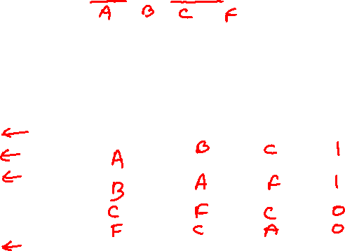
Minimized state table
(AD)(B)(CEG)(F)
Present
Next state
Output
state
z
Present
Nextstate
Output
w
=
0
w
=
1
state
w
=
0
w
=
1
z
A
B
C
1
B
D
F
1
C
F
E
0
D
B
G
1
E
F
C
0
F
E
D
0
G
F
G
0
The symbol A represent both the states A and D
The symbol C represent the states C, E, and G
[ Figure 6.52 from the textbook ]

Slide 72
Minimized state table
Present
Next state
Output
state
z
Present
Nextstate
Output
w
=
0
w
=
1
state
w
=
0
w
=
1
z
A
B
C
1
B
D
F
1
A
B
C
1
C
F
E
0
B
A
F
1
D
B
G
1
C
F
C
0
E
F
C
0
F
C
A
0
F
E
D
0
G
F
G
0
The symbol A represent both the states A and D
The symbol C represent the states C, E, and G
[ Figure 6.52 from the textbook ]

Slide 73
Minimized state table
Present
Next state
Output
state
z
Present
Nextstate
Output
w
=
0
w
=
1
state
w
=
0
w
=
1
z
A
B
C
1
B
D
F
1
A
B
C
1
C
F
E
0
B
A
F
1
D
B
G
1
C
F
C
0
E
F
C
0
F
C
A
0
F
E
D
0
G
F
G
0
The symbol A represent both the states A and D
The symbol C represent the states C, E, and G
[ Figure 6.52 from the textbook ]

Slide 74
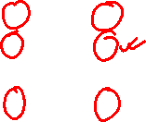
State Table for This Example
Next state
Partitioning:
Present
Output
state
w
=
0
w
=
1
z
P1: (ABCDEFG)
P2: (ABD) (CEGF)
P3: (ABD) (CEG) (F)
P4: (B) (AD) (CEG) (F)
P5: (B) (AD) (CEG) (F)
A
B
C
1
B
D
F
1
C
F
E
0
D
B
G
1
E
F
C
0
F
E
D
0
G
F
G
0
[ Figure 6.51 from the textbook ]

Slide 75
Vending Machine Example

Slide 76
Vending Machine Example
The machine accepts nickels and dimes
It takes 15 cents for a piece of candy to be released from the machine
If 20 cents is deposited, the machine will not return the change, but it will credit the buyer with 5 cents and wait for the buyer to make a second purchase.

Slide 77
Signals for the vending machine
Clock
sense
N
sense
D
N
D
(a) Timing diagram
N
sense
N
D
Q
D
Q
Clock
Q
Q
(b) Circuit that generates
N
[ Figure 6.53 from the textbook ]

Slide 78
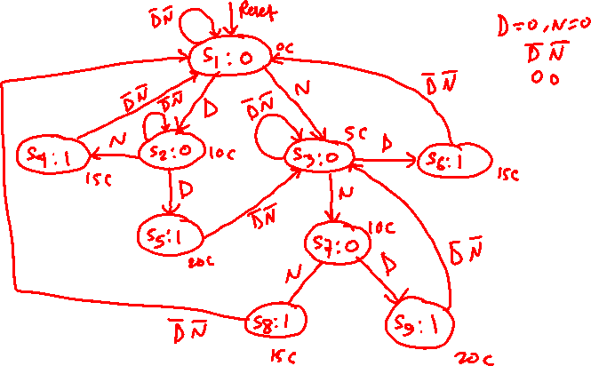
State Diagram for the vending machine
[ Figure 6.54 from the textbook ]

Slide 79
State Diagram for the vending machine
DN
0c
Reset
DN
S1
⁄
DN
0
DN
DN
DN
15c
D
N
15c
10c
5c
D
S2
⁄
⁄
S4
⁄
0
S3
0
⁄
1
S7
1
N
D
N
DN
10c
S6
⁄
S5
⁄
0
1
20c
DN
DN
N
D
20c
S8
⁄
⁄
15c
1
S9
1
[ Figure 6.54 from the textbook ]

Slide 80
State Table for the vending machine
Present
Next state
Output
Incompletely specified state table
state
DN
=00
01
10
11
z
S1
S1
S3
S2
–
0
S2
S2
S4
S5
–
0
S3
S3
S6
S7
–
0
S4
S1
–
–
–
1
S5
S3
–
–
–
1
S6
S6
S8
S9
–
0
S7
S1
–
–
–
1
S8
S1
–
–
–
1
S9
S3
–
–
–
1
[ Figure 6.55 from the textbook ]

Slide 81
Partition for Vending Machine FSM
Present state | Next state |  |  |  | Output
 | 00 | 01 | 10 | 11 | z
S1 | S1 | S3 | S2 | - | 0
S3 | S3 | S6 | S7 | - | 0
S2 | S2 | S4 | S5 | - | 0
S6 | S6 | S8 | S9 | - | 0
S4 | S1 | - | - | - | 1
S7 | S1 | - | - | - | 1
S8 | S1 | - | - | - | 1
S5 | S3 | - | - | - | 1
S9 | S3 | - | - | - | 1
P1=(S1,S2,S3,S4,S5,S6,S7,S8,S9)

Slide 82
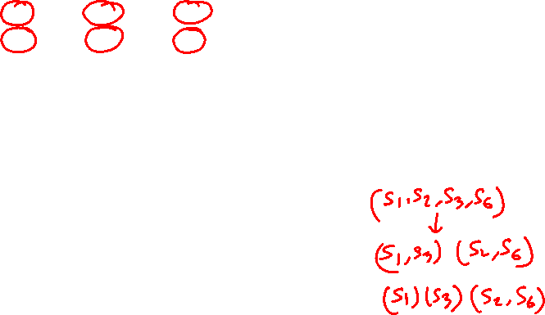
Partition for Vending Machine FSM
Present state | Next state |  |  |  | Output
 | 00 | 01 | 10 | 11 | z
S1 | S1 | S3 | S2 | - | 0
S3 | S3 | S6 | S7 | - | 0
S2 | S2 | S4 | S5 | - | 0
S6 | S6 | S8 | S9 | - | 0
S4 | S1 | - | - | - | 1
S7 | S1 | - | - | - | 1
S8 | S1 | - | - | - | 1
S5 | S3 | - | - | - | 1
S9 | S3 | - | - | - | 1
P1=(S1,S2,S3,S4,S5,S6,S7,S8,S9)
P2=(S1,S2,S3,S6) (S4,S5,S7,S8,S9)

Slide 83
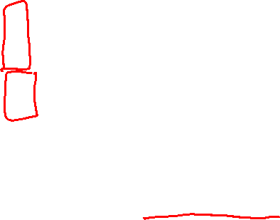
Partition for Vending Machine FSM
Present state | Next state |  |  |  | Output
 | 00 | 01 | 10 | 11 | z
S1 | S1 | S3 | S2 | - | 0
S3 | S3 | S6 | S7 | - | 0
S2 | S2 | S4 | S5 | - | 0
S6 | S6 | S8 | S9 | - | 0
S4 | S1 | - | - | - | 1
S7 | S1 | - | - | - | 1
S8 | S1 | - | - | - | 1
S5 | S3 | - | - | - | 1
S9 | S3 | - | - | - | 1
P1=(S1,S2,S3,S4,S5,S6,S7,S8,S9)
P2=(S1,S2,S3,S6) (S4,S5,S7,S8,S9)
P3=(S1) (S3) (S2,S6) (S4,S5,S7,S8,S9)

Slide 84
Partition for Vending Machine FSM
Present state | Next state |  |  |  | Output
 | 00 | 01 | 10 | 11 | z
S1 | S1 | S3 | S2 | - | 0
S3 | S3 | S6 | S7 | - | 0
S2 | S2 | S4 | S5 | - | 0
S6 | S6 | S8 | S9 | - | 0
S4 | S1 | - | - | - | 1
S7 | S1 | - | - | - | 1
S8 | S1 | - | - | - | 1
S5 | S3 | - | - | - | 1
S9 | S3 | - | - | - | 1
P1=(S1,S2,S3,S4,S5,S6,S7,S8,S9)
P2=(S1,S2,S3,S6) (S4,S5,S7,S8,S9)
P3=(S1) (S3) (S2,S6) (S4,S5,S7,S8,S9)
P4=(S1) (S3) (S2,S6) (S4,S7,S8) (S5,S9)

Slide 85
Partition for Vending Machine FSM
Present state | Next state |  |  |  | Output
 | 00 | 01 | 10 | 11 | z
S1 | S1 | S3 | S2 | - | 0
S3 | S3 | S6 | S7 | - | 0
S2 | S2 | S4 | S5 | - | 0
S6 | S6 | S8 | S9 | - | 0
S4 | S1 | - | - | - | 1
S7 | S1 | - | - | - | 1
S8 | S1 | - | - | - | 1
S5 | S3 | - | - | - | 1
S9 | S3 | - | - | - | 1
P1=(S1,S2,S3,S4,S5,S6,S7,S8,S9)
P2=(S1,S2,S3,S6) (S4,S5,S7,S8,S9)
P3=(S1) (S3) (S2,S6) (S4,S5,S7,S8,S9)
P4=(S1) (S3) (S2,S6) (S4,S7,S8) (S5,S9)
P5=(S1) (S3) (S2,S6) (S4,S7,S8) (S5,S9)

Slide 86
Partition for Vending Machine FSM
Present state | Next state |  |  |  | Output
 | 00 | 01 | 10 | 11 | z
S1 | S1 | S3 | S2 | - | 0
S3 | S3 | S6 | S7 | - | 0
S2 | S2 | S4 | S5 | - | 0
S6 | S6 | S8 | S9 | - | 0
S4 | S1 | - | - | - | 1
S7 | S1 | - | - | - | 1
S8 | S1 | - | - | - | 1
S5 | S3 | - | - | - | 1
S9 | S3 | - | - | - | 1
P1=(S1,S2,S3,S4,S5,S6,S7,S8,S9)
P2=(S1,S2,S3,S6) (S4,S5,S7,S8,S9)
P3=(S1) (S3) (S2,S6) (S4,S5,S7,S8,S9)
P4=(S1) (S3) (S2,S6) (S4,S7,S8) (S5,S9)
P5=(S1) (S3) (S2,S6) (S4,S7,S8) (S5,S9)

Slide 87
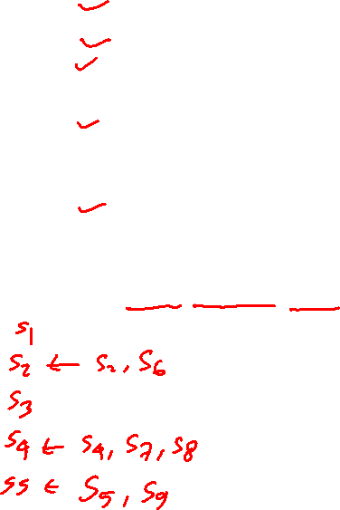
Minimized State Table for the vending machine
Present state | Next state |  |  |  | Output
 | 00 | 01 | 10 | 11 | z
S1 | S1 | S3 | S2 | - | 0
S3 | S3 | S6 | S7 | - | 0
S2 | S2 | S4 | S5 | - | 0
S6 | S6 | S8 | S9 | - | 0
S4 | S1 | - | - | - | 1
S7 | S1 | - | - | - | 1
S8 | S1 | - | - | - | 1
S5 | S3 | - | - | - | 1
S9 | S3 | - | - | - | 1
Present
Next state
Output
P5=(S1)(S3) (S2,S6)(S4,S7,S8)(S5,S9)
state
DN
=00
01
10
11
z
S1
S1
S3
S2
–
0
S2
S2
S4
S5
–
0
S3
S3
S2
S4
–
0
S4
S1
–
–
–
1
S5
S3
–
–
–
1
[ Figure 6.56 from the textbook ]

Slide 88
Minimized State Diagram for the vending machine
DN
Next state
Present
Output
state
DN
=00
01
10
11
z
S1
⁄
0
S1
S1
S3
S2
–
0
S2
S2
S4
S5
–
0
N
S3
S3
S2
S4
–
0
DN
S4
S1
–
–
–
1
S3
⁄
0
S5
S3
–
–
–
1
D
DN
N
DN
DN
S2
⁄
0
D
S5
⁄
1
N
D
S4
⁄
1
[ Figure 6.57 from the textbook ]

Slide 89
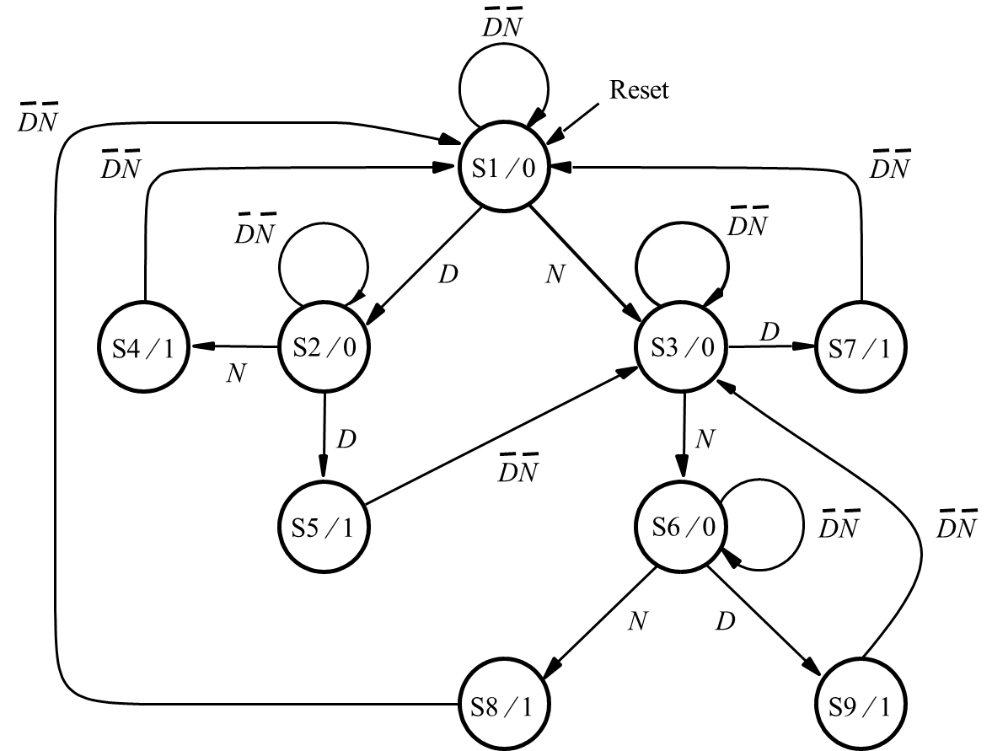
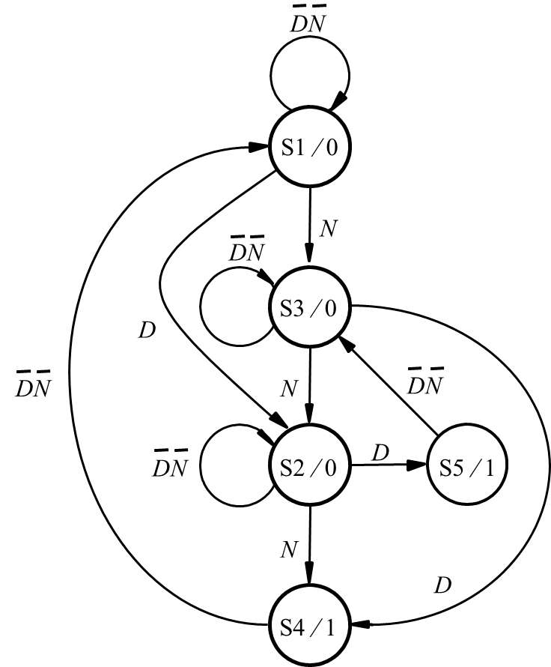
Minimized State Diagram for the vending machine
[ Figure 6.57 from the textbook ]

Slide 90
Mealy-type FSM for the vending machine
[ Figure 6.58 from the textbook ]

Slide 91
Mealy-type FSM for the vending machine
DN
⁄
0
S1
N
⁄
⁄
0
D
1
DN
⁄
0
N
⁄
S3
⁄
1
D
0
N
⁄
⁄
0
D
1
S2
DN
⁄
0
[ Figure 6.58 from the textbook ]

Slide 92
Incompletely specified state table
The partitioning scheme for minimization of states works well when all entries in the state table are specified.
If one or more entries in the state table are not specified, corresponding to don’t-care conditions, then the FSM is said to be incompletely specified.
[ Figure 6.59 from the textbook ]

Slide 93
Incompletely specified state table: Example
Present
Next state
Output
z
state
w
=
0
w
=
1
w
=
0
w
=
1
A
B
C
0
0
B
D
–
0
–
C
F
E
0
1
D
B
G
0
0
E
F
C
0
1
F
E
D
0
1
G
F
–
0
–
[ Figure 6.59 from the textbook ]

Slide 94
Incompletely specified state table: Example
Present
Next state
Output
z
state
w
=
0
w
=
1
w
=
0
w
=
1
A
B
C
0
0
B
D
–
0
0
C
F
E
0
1
D
B
G
0
0
E
F
C
0
1
F
E
D
0
1
G
F
–
0
0
Not knowing whether these values should be 0 or 1, let us first assume that both unspecified outputs have a value of 0.
[ Figure 6.59 from the textbook ]

Slide 95
Incompletely specified state table: Example
Present
Next state
Output
z
state
w
=
0
w
=
1
w
=
0
w
=
1
A
B
C
0
0
B
D
–
0
0
C
F
E
0
1
D
B
G
0
0
E
F
C
0
1
F
E
D
0
1
G
F
–
0
0
P1 = (ABCDEFG)
P2 = (ABDG)(CEF)
P3 = (AB)(D)(G)(CE)(F)
P4 = (A)(B)(D)(G)(CE)(F)
P5 = P4
[ Figure 6.59 from the textbook ]

Slide 96

END Slide

